Slide 1


Department of Artificial Intelligence and Data science
Alzheimer’s Detection: A MRI and Machine Learning approach
Mrs. Thamizharasi M, M.Tech.
(Assistant Professor)
Abhijit R(221801001)
Monish Raja Rathinam M (221801033)

Slide 2
Problem Statement and Motivation
Alzheimer’s disease is a progressive neurological disorder that leads to memory loss and cognitive decline. Early diagnosis is crucial for managing the disease's progression. Imaging techniques like MRI can be complex and time-consuming for manual analysis.
There is a need for an automated, accurate, and efficient method to assist in the early detection of Alzheimer's disease by analyzing hippocampal structures from brain imaging data.
Motivation
Current diagnosis methods are subjective and often performed at advanced stages.
The use of AI and deep learning can assist in the early detection of Alzheimer's from medical images like MRI scans.

Slide 3
Objectives
Efficiently preprocess MRI scans for clear feature extraction.
To develop a deep learning-based system capable of detecting early signs of Alzheimer’s disease by analysing hippocampus regions in ADNI dataset.
Compare the accuracy of the system with existing diagnostic methods and identify improvement areas.

Slide 4
Abstract
Alzheimer's disease is a progressive neurodegenerative disorder that affects millions of people worldwide, with early diagnosis being critical for effective treatment and management. This project proposes an automated system that uses deep learning, specifically autoencoders, to detect early signs of Alzheimer's by analyzing MRI scans of the brain. The system focuses on the hippocampus region, which is significantly impacted in Alzheimer's patients. By applying image processing techniques such as thresholding, edge detection, and skeletonization, key features are extracted from MRI images. The autoencoder model is trained to predict structural abnormalities, allowing for early detection of the disease.

Slide 5
Introduction and Overview of the Project.
This project aims to develop an automated system that leverages deep learning techniques, particularly autoencoders, to detect early signs of Alzheimer's by analyzing MRI scans of the brain, specifically focusing on the hippocampus region, which is known to be affected in Alzheimer's patients.
The system processes MRI images using image processing techniques such as thresholding, edge detection, and feature extraction to isolate key regions of interest. A deep learning model, such as an autoencoder, is then trained to predict abnormalities in these brain regions that may indicate early stages of Alzheimer's. The project focuses on improving diagnostic accuracy, and enabling earlier detection to provide timely intervention for patients.

Slide 6
Literature Survey
S.No | Author Name | Paper Title | Description | Journal | Volume/ Year
1. | A. Balasundaram | Hippocampus Segmentation-Based Alzheimer’s Disease Diagonsis and Classification of MRI Images | The study investigates early diagnosis of Alzheimer's disease by comparing models trained on segmented hippocampus regions against those trained on full MRI images. | King Fahd University of Petroleum & Minerals. | 2023
2. | Dr. R. V. Babar | Alzheimer’s Disease Detection using Machine Learning Techniques in 3D MR Images | study proposes novel complexity-based features for EEG signal analysis to improve diagnostic accuracy, sensitivity, and specificity in early Alzheimer's disease detection. | International Journal of Advanced Research in Science, Communication and Technology (IJARSCT) | 2022
3. | Ramadhan Sanyoto Sugiharso Widodo | Volumetric Hippocampus Segmentation Using 3D U-Net Based On Transfer Learning | A 3D U-Net architecture with transfer learning is proposed for hippocampal segmentation in MRI, achieving high accuracy metrics while reducing computational complexity and processing time. | IEEE International Conference on Computational Intelligence and Virtual Environments for Measurement Systems and Applications (CIVEMSA) | 2024

Slide 7
Literature Survey
S.No | Author Name | Paper Title | Description | Journal | Volume/ Year
4. | Sina Fathi | A Deep Learning-Based Ensemble Method for Early Diagnosis of Alzheimer’s Disease using MRI Images | This study developed a deep learning ensemble model for early Alzheimer’s diagnosis, showing high accuracy with MRI data, outperforming individual models. | Neuroinformatics Iran University of Medical Sciences | 2023
5. | Amira Ben Rabeh | Detection of Alzheimer disease using deep learning | Detection of Alzheimer's disease in early stages is achieved using deep learning on MRI images. The proposed method with ResNet50 network achieves exceptional accuracy of 96.8%. | Journal of Advanced Zoology | 2023
6. | M. M. B. S. Sree | Early detection of Alzheimer’s Disease using Deep Learning | It emphasizes the role of various Deep Learning algorithms in identifying the disease at its earliest stages, which is crucial for effective intervention and management | Indian Scientific Journal Of Research In Engineering And Management | 2024

Slide 8
Existing System
Existing systems for diagnosing Alzheimer's disease (AD) with deep learning use hippocampal biomarkers to improve accuracy and efficiency. Deep learning models, particularly Convolutional Neural Networks (CNNs), automatically segment the hippocampus from MRI scans, allowing precise measurement of hippocampal volume and atrophy—key indicators of AD.
Systems may also integrate hippocampal data with other biomarkers, like amyloid plaques, for a more comprehensive assessment. By reducing human error and automating the analysis, these systems offer consistent, reliable, and personalized diagnostics, enhancing early diagnosis and treatment planning.

Slide 9
Drawback of Existing System
The segmentation of the hippocampus region for Alzheimer's disease diagnosis may overlook other brain regions that could also be indicative of the disease, potentially leading to missed diagnoses.
The comparison between models trained on segmented portions of MRI images and models trained on complete images may not fully capture the complexity of Alzheimer's disease diagnosis, as other brain regions could play significant roles in the classification process.
The study did not investigate the robustness of the proposed approach to variations in MRI image quality, resolution, or noise levels, which are common challenges in real-world clinical imaging scenarios.

Slide 10
Proposed System
Hippocampus-Based Image Processing: The system processes MRI scans of the brain, focusing on the hippocampus region, a critical area for detecting early signs of Alzheimer’s disease. It uses image processing techniques (OpenCV) to merge and enhance the left and right hippocampal areas, preparing them for analysis.
Autoencoder Model for Feature Extraction: The core of the system is an autoencoder, a deep learning model composed of two parts: an encoder and a decoder. The encoder extracts meaningful features from the hippocampus images using convolutional layers (Conv2D), while the decoder reconstructs these images using transposed convolutional layers (Conv2DTranspose).
Image Reconstruction and Prediction: After training on a dataset of hippocampus images, the system predicts and reconstructs unseen hippocampus scans. These predictions are visualized alongside the original images using matplotlib for comparison

Slide 11
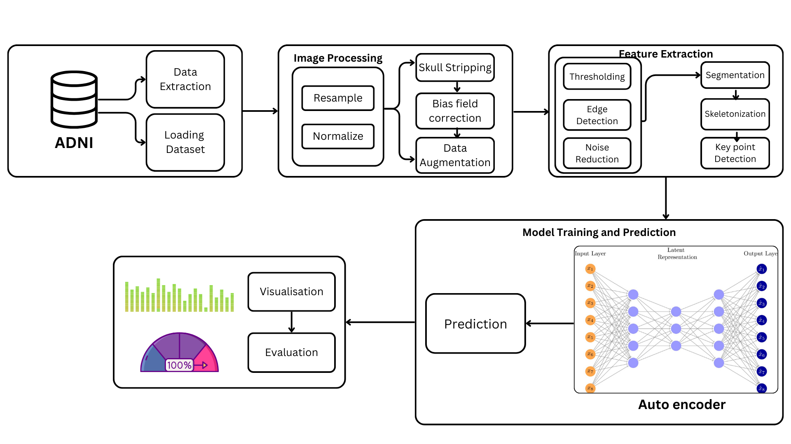
System Architecture

Slide 12
Modules
Data Preprocessing Module
Feature Extraction and Segmentation Module
Model Training Module
Visualization and Evaluation Module

Slide 13
Data Preprocessing Module
The data preprocessing module is a critical foundation for analyzing MRI scans, ensuring the dataset is clean, consistent, and optimized for feature extraction and model training. By standardizing image formats, correcting artifacts, and enhancing essential features, the module prepares the data to accurately reflect structural changes in the brain.
These transformations minimize noise, improve clarity, and focus the analysis on key regions like the hippocampus, essential for reliable Alzheimer's detection.

Slide 14
Data Preprocessing - Techniques
Normalization: Adjusts pixel intensities across images to reduce variability caused by different scanning devices, ensuring uniform contrast.
Resampling: Standardizes MRI image resolution (e.g., 256x256 pixels), enabling consistent feature representation across the dataset.
Skull Stripping: Removes non-brain elements like skull and scalp to focus exclusively on brain regions like the hippocampus.
Bias Field Correction: Addresses intensity inhomogeneities caused by MRI magnetic field variations, ensuring better contrast and clarity.
Data Augmentation: Applies random transformations (e.g., rotations, flips) to artificially increase the dataset size, improving model robustness.

Slide 15
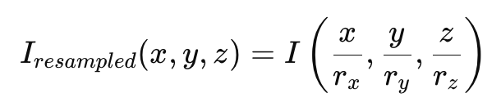
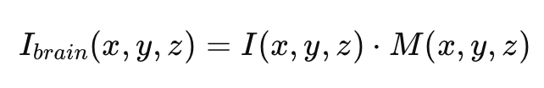
Data Preprocessing – Algorithm
Objective: Prepare MRI images for further processing.
Steps:
Resampling:
Uniformly resample all MRI images to a standard voxel size for consistency.
Key Equation:
2. Skull Stripping:
Remove non-brain tissues using a binary brain mask MM.
Key Equation:

Slide 16
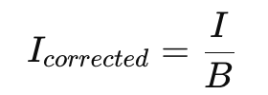
Data Preprocessing – Algorithm
3. Bias Field Correction:
Correct for intensity inhomogeneities caused by MRI acquisition.
Key Equation:
4. Data Augmentation:
Enhance the dataset by applying transformations such as rotation, flipping, and scaling.
Example Equation for Rotation:

Slide 17
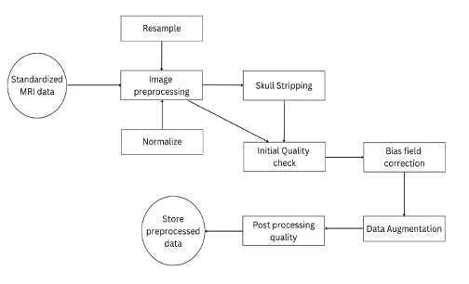
Data Preprocessing Module DFD

Slide 18
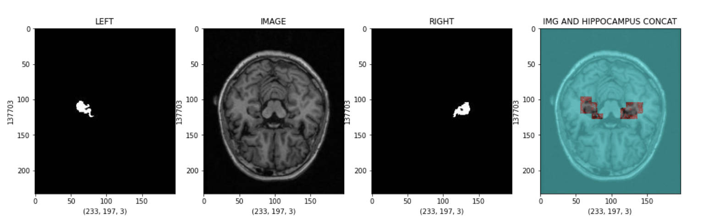
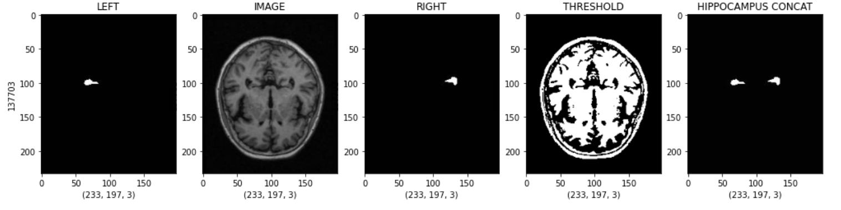
Data Preprocessing Module Output

Slide 19
Feature extraction Module
The feature extraction and segmentation module isolates and enhances diagnostically significant regions of the brain, such as the hippocampus, from MRI scans. By employing advanced techniques like edge detection, thresholding, and morphological operations, it highlights structural changes associated with Alzheimer's disease.
This module transforms raw image data into actionable features, ensuring that only the most relevant details are passed to the predictive models for analysis.

Slide 20
Feature extraction Module - Techniques
Edge Detection (Canny Method): Detects sharp intensity changes to outline the hippocampus, providing clear boundaries for segmentation.
Thresholding: Segments the hippocampus based on intensity values, isolating it from surrounding brain tissue for focused analysis.
Skeletonization: Reduces the hippocampus to its core structure, preserving critical anatomical details while simplifying its representation.
Keypoint Detection: Identifies specific points of interest within the hippocampus, capturing localized features indicative of Alzheimer's progression.

Slide 21
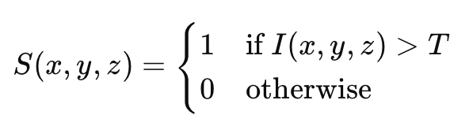
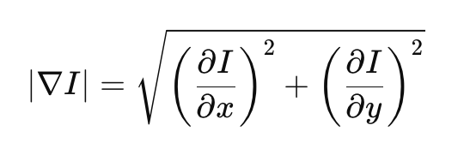


Feature extraction Module – Algorithm
Thresholding:
Segment the image based on intensity values.
Key Equation:
2. Edge Detection:
Identify hippocampus boundaries by calculating gradient magnitudes.
Key Equation:
3. Autoencoder-based Segmentation:
Use an autoencoder for hippocampus segmentation.
Key Equations:
Encoder compresses the image:
Decoder reconstructs the segmentation mask:

Slide 22
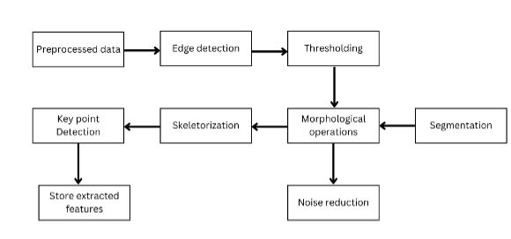
Feature extraction Module DFD

Slide 23
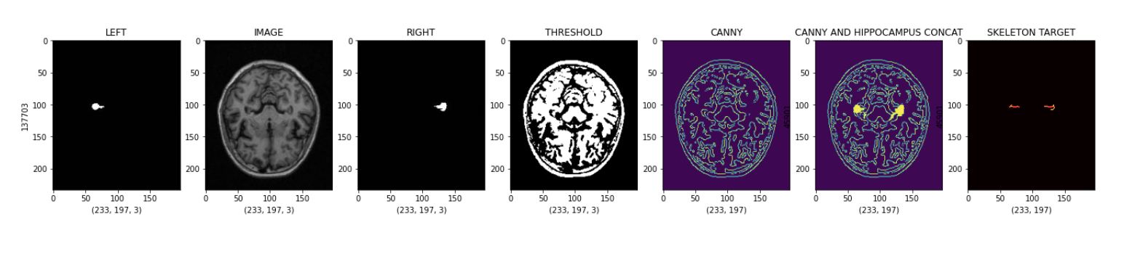
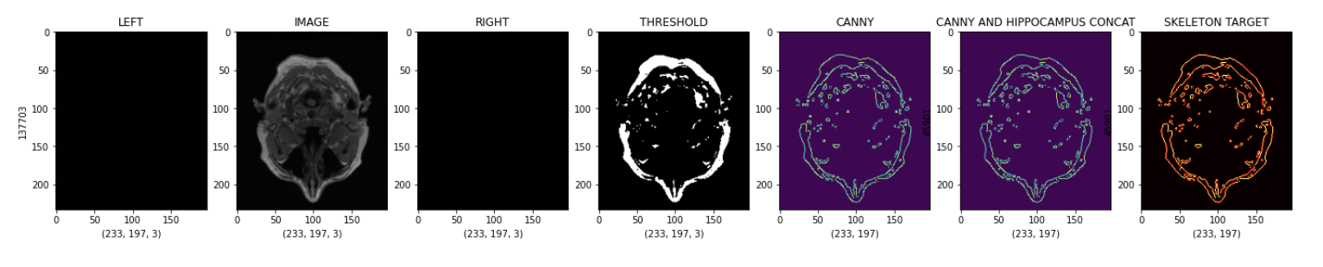
Feature extraction Output

Slide 24
Model Training Module
The model training and prediction module forms the core of the Alzheimer's detection system. It leverages advanced deep learning techniques, such as autoencoders, to analyze hippocampal features extracted from MRI scans. By learning patterns of structural anomalies, the model distinguishes between normal and Alzheimer's-affected brains with high accuracy.
This module is pivotal in transforming extracted features into actionable predictions for early diagnosis.

Slide 25
Model Training Module - Techniques
Autoencoder Architecture: A neural network that compresses hippocampal features into a latent space and reconstructs them, highlighting structural anomalies.
Latent Space Representation: Captures the hippocampus's essential characteristics in a reduced-dimensional form, preserving diagnostically significant details.
Reconstruction Error: Measures the difference between the original and reconstructed images, identifying anomalies indicative of Alzheimer's.

Slide 26
Model Training Module – Techniques(contd.)
Convolutional Layers: Extract hierarchical features from input MRI scans, enabling the model to recognize complex patterns.
Threshold-based Classification: Uses reconstruction error thresholds to classify scans as normal or Alzheimer's-affected.
Evaluation Metrics: Metrics such as accuracy, ROC-AUC, and confusion matrix validate the model's performance in predicting Alzheimer's cases.

Slide 27
Model Training Module – Algorithm
Data Preparation
Input: Preprocessed MRI images and their corresponding hippocampus masks.
Steps:
Split the dataset into training, validation, and test subsets (e.g., 70%-15%-15% split).
Normalize the pixel values of images to a range of [0,1][0,1] for faster convergence during training.
Autoencoder Architecture
Input: MRI image of shape (H,W,C)(H,W,C), where H=Height,W=Width,C=ChannelsH=Height,W=Width,C=Channels.
Output: Segmentation mask of the hippocampus.
Structure:
Encoder:
Compresses the input image into a latent representation ZZ.
Consists of a series of convolutional layers, ReLU activation functions, and max-pooling layers for downsampling.

Slide 28
Model Training Module – Algorithm
Decoder:
Expands the latent representation ZZ back to the size of the input image, producing a segmentation mask.
Uses transpose convolutional layers (upsampling) and activation functions.
Training Loop
For Each Epoch:
Training Phase:
Pass batches of images through the model.
Compute predictions and loss.
Perform backpropagation to update weights.
Validation Phase:
Evaluate the model on the validation dataset to monitor overfitting.

Slide 29
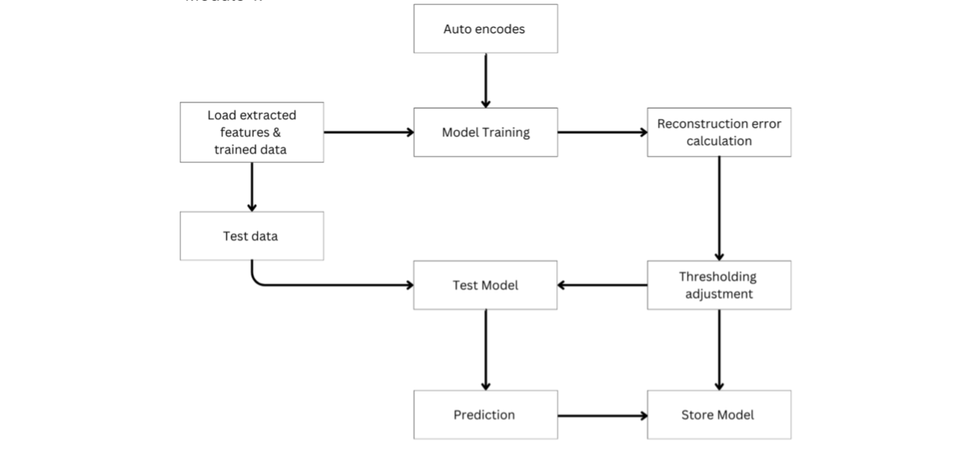
Model Training Module DFD

Slide 30
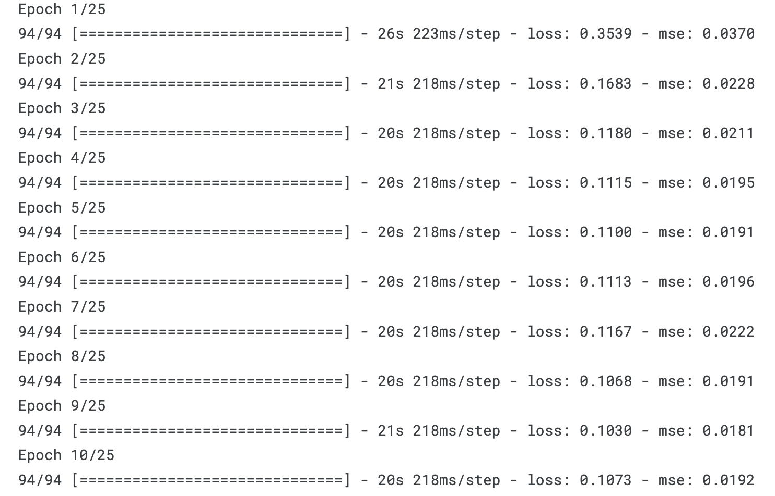
Model Training Module Output

Slide 31
Visualisation and Evaluation Module
The visualization and evaluation module assesses the model’s performance and provides interpretable insights for Alzheimer's diagnosis. It uses metrics like accuracy, confusion matrix, and ROC-AUC to quantify model efficiency and employs visual tools like reconstruction error plots and heatmaps.
This module ensures the model is robust and its predictions are both reliable and transparent for clinical applications.

Slide 32
Visualisation and Evaluation Module – Techniques
ROC-AUC Curve: Plots the true positive rate against the false positive rate, providing a comprehensive measure of the model’s predictive capability.
Accuracy, Precision, and Recall: Quantifies the model's performance in correctly identifying cases and minimizing misclassification.
Reconstruction Error Histogram: Visualizes the distribution of reconstruction errors to distinguish between normal and Alzheimer's cases.
Performance Comparison: Compares various metrics across models, validating the robustness of the selected approach.

Slide 33
Visualisation and Evaluation Module – Algorithm
1. Input: Predictions, true labels, and reconstruction errors from the model.
2. Compute evaluation metrics:
a. Generate confusion matrix for true/false positives and negatives.
b. Calculate accuracy, precision, recall, and F1-score.
c. Plot ROC curve and compute AUC.
3. Visualize reconstruction error:
a. Create histogram of reconstruction error distribution.
b. Separate clusters for normal and Alzheimer’s cases.
4. Generate heatmaps:
a. Overlay high reconstruction error regions on original MRI scans.
b. Highlight anomalies for interpretability.
5. Output: Metrics and visualizations for model evaluation and interpretation.

Slide 34
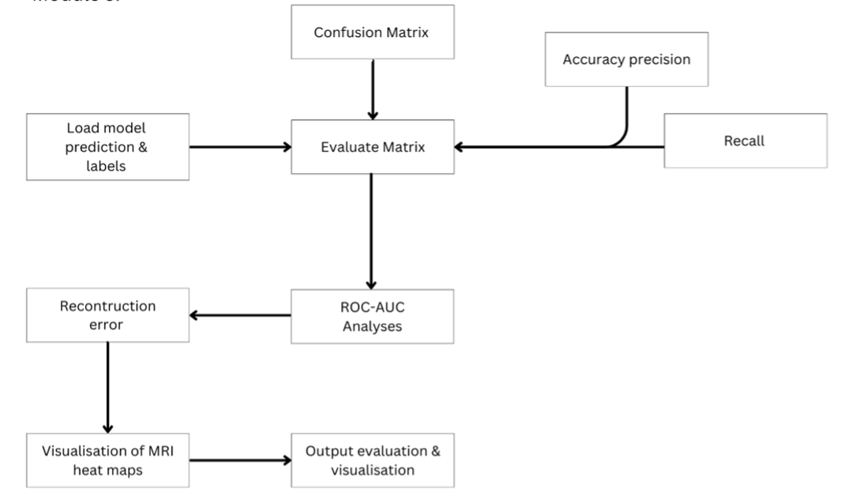
Visualisation and Evaluation Module DFD

Slide 35
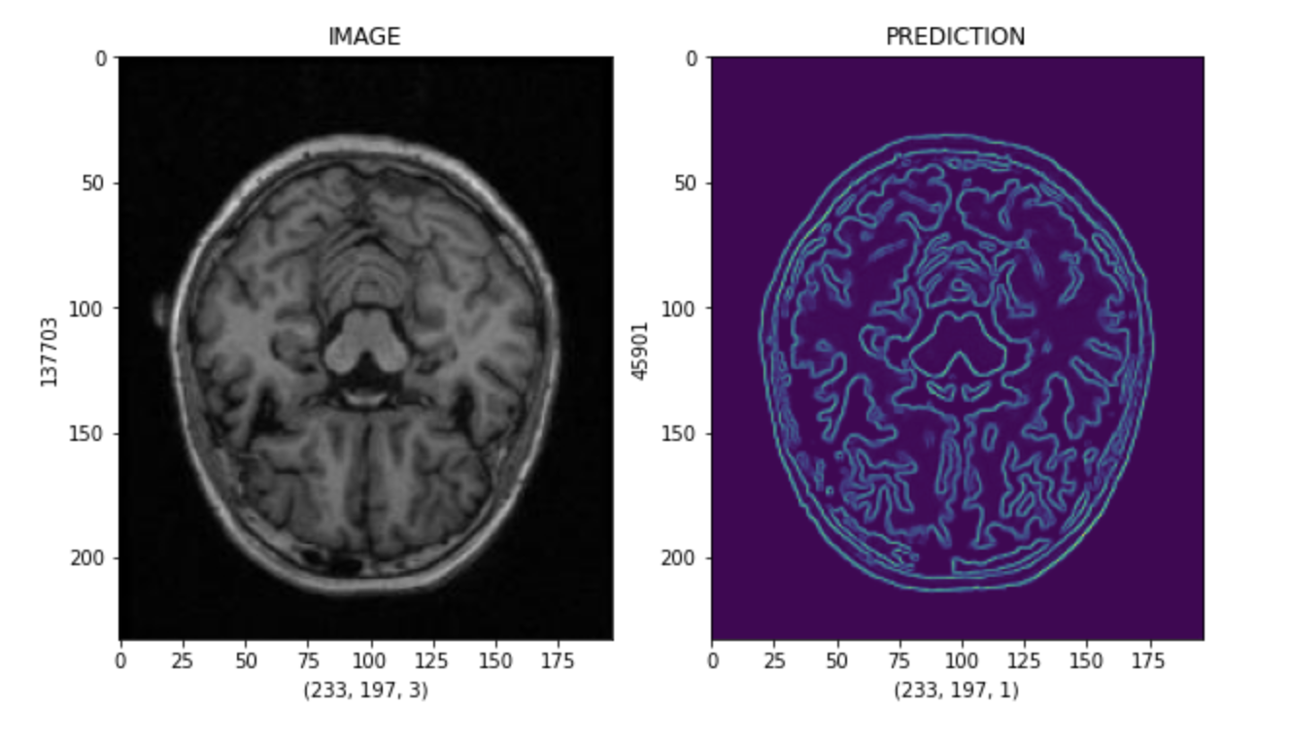
Visualisation and Evaluation Module Output

Slide 36
Result and Discussion
1. Performance of Autoencoder vs. 3D CNN and CNN-LSTM
The autoencoder, 3D CNN, and CNN-LSTM models' accuracy, precision, recall, and F1-score are contrasted in the bar chart. According to the results, the CNN-LSTM comes in second, taking advantage of both spatial and temporal processing, while the 3D CNN attains the best accuracy and recall, demonstrating superiority in accurately diagnosing Alzheimer's cases.

Slide 37
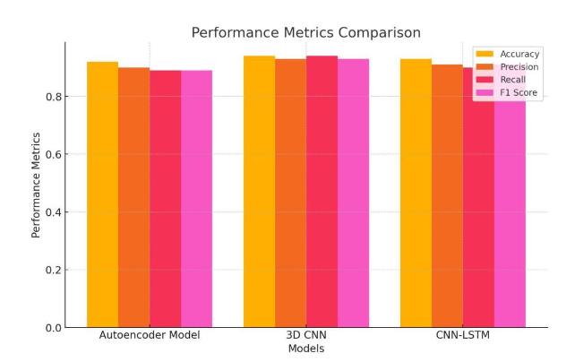
Result and Discussion
1. Performance of Autoencoder vs. 3D CNN and CNN-LSTM(Contd.)

Slide 38
Result and Discussion
2. ROC Curve Comparison
While the CNN-LSTM performs similarly well, the 3D CNN achieves the best AUC, demonstrating its robustness for direct classification. Because the autoencoder focuses on anomaly detection through reconstruction error rather than straight classification, it has a somewhat lower AUC. Because of this, the autoencoder is especially well-suited to detecting subtle structural alterations linked to early Alzheimer's disease, enhancing conventional classification methods.

Slide 39
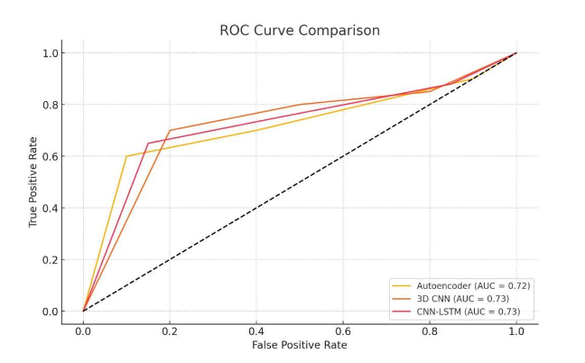
Result and Discussion
2. ROC Curve Comparison(Contd.)

Slide 40
Result and Discussion
3. Reconstruction Error Distribution
The autoencoder's capacity to distinguish between normal and Alzheimer’s cases based on structural defects is demonstrated by its reconstruction error distribution histogram. Alzheimer's patients have larger error values, most likely as a result of anatomical abnormalities like hippocampus shrinkage, whereas normal cases tend to cluster around lower error values. This distribution supports the autoencoder's ability to detect structural anomalies, which, when combined with classification models, may provide a benefit in the early identification of Alzheimer's disease.

Slide 41
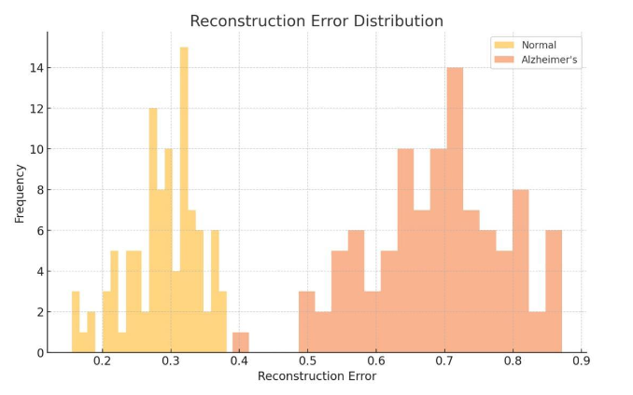
Result and Discussion
3. Reconstruction Error Distribution(Contd.)

Slide 42
Result and Discussion
4. Full Features vs Segmented Features Comparison(contd.)
The Full Features set (orange line) generally leads to more stable and, in some cases, higher performance across classifiers, particularly in models like Logistic Regression, Neural Network, and Linear SVM, which benefit from the richer data. However, certain models, such as LDA and QDA, show consistent results with Segmented Features (blue line), suggesting that focused feature sets are often sufficient for simpler models that rely on specific, distinguishing features.

Slide 43
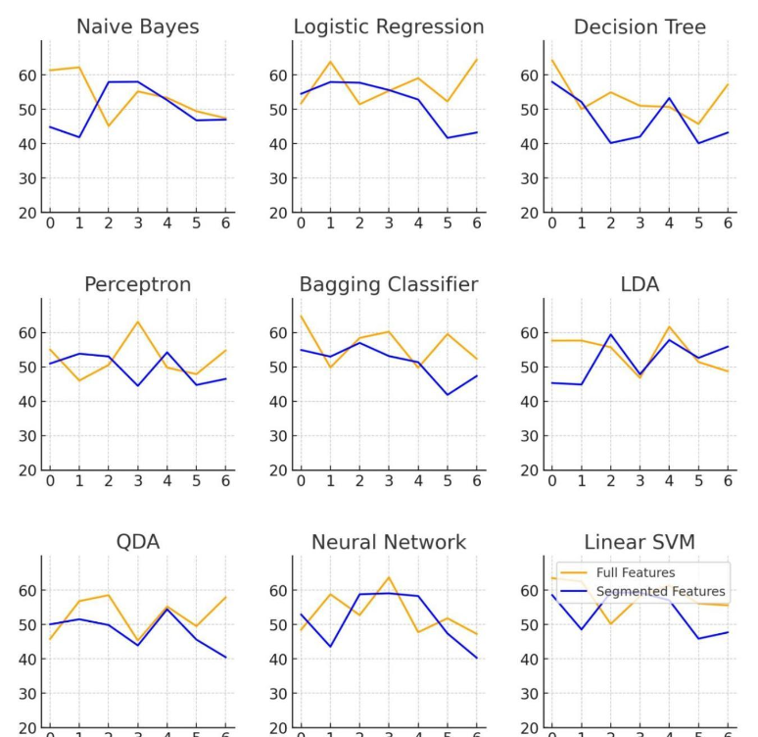
Result and Discussion
4. Full Features vs Segmented Features Comparison(contd.)

Slide 44
Conclusion
This Alzheimer's detection framework emphasizes high-quality data preprocessing, such as standardization, normalization, and skull stripping, and uses MRI data for early diagnosis. By concentrating on the hippocampus, a crucial area for early Alzheimer's symptoms, it makes it possible to extract features that effectively capture minute structural alterations. The framework incorporates complementary models: the autoencoder detects early-stage abnormalities through reconstruction error, while the 3D CNN and CNN-LSTM perform well in direct classification tasks. This all-encompassing method offers a strong basis for better Alzheimer's diagnosis and may prove to be a useful instrument in clinical settings for precise and timely intervention.

Slide 45
References.
Balasundaram, Ananthakrishnan & Srinivasan, Sruthi & Prasad, A. & Malik, Jahan & Kumar, Ayush. (2023). Hippocampus Segmentation-Based Alzheimer’s Disease Diagnosis and Classification of MRI Images. Arabian Journal for Science and Engineering. 48. 1-17. 10.1007/s13369-022-07538-2.
V. L. Nagaveni, D. Rajeswara Rao and S. Neeharika, "ABC Optimised CNN model for classifying Alzheimer's Disease stages," 2024 Fourth International Conference on Advances in Electrical, Computing, Communication and Sustainable Technologies (ICAECT), Bhilai, India, 2024, pp. 1-8, doi: 10.1109/ICAECT60202.2024.10469460.
Kara, Esra & Toelke, Sophia & Onur, Oezguer. (2023). Volume of the posterior and not anterior hippocampus predicts spatial memory performance in Alzheimer´s Disease. Alzheimer's & Dementia. 19. 10.1002/alz.076698.
D., Dr & Sathees, Prabha. (2019). Analysis of brain sub regions using optimization techniques and deep learning method in Alzheimer disease. Applied Soft Computing. 86. 105857. 10.1016/j.asoc.2019.105857.
Zhang, Bingyi. (2023). Alzheimers disease course prediction methods based on deep learning methods. Theoretical and Natural Science. 22. 157-163. 10.54254/2753-8818/22/20230970.

Slide 46
Thank You

